Slide 1
Mr. John Imhof- IB Coordinator 797-7010 ext.239 imhof_ j@hcsb.k12.fl.us
F.W. Springstead High School

Slide 2
Student Learning Opportunities in Hernando County
Attend zoned high school- take variety of Honors and Advanced Placement Courses; traditional Bright Futures
NCTHS- Vocational Programs; DE & AP Classes; traditional Bright Futures (Zone and Magnet)
CHS- AICE Program; AP & AICE Classes; AICE Diploma = 100% Bright Futures (Magnet)
Dual Enrollment- pass PERT test; take DE on school or PHSC Campus, earn college credit (Zone Only- classes vary by site)
SHS- International Baccalaureate- IB Diploma Programme; AP Capstone Program; AP and IB Classes; IB Diploma = 100% Bright Futures (Magnet)

Slide 3
College Admissions Factors
Weighted GPA/Class Rank
SAT/ACT Scores
Strength of Schedule (Rigor)
School Profile- class size, subjects offered, etc…
Letter of Recommendation*
Advanced Placement Classes (18):
Biology
Calculus AB
Capstone: Seminar
Capstone: Research
Comparative/U.S. Govt & Pol
English Language
English Literature
Environmental Science
Human Geography
Macroeconomics/ Microeconomics
Music Theory*
Psychology
Spanish Language
Spanish Literature
Studio Art
U.S. History
World History
IB World Classes (13):
Biology HL
Chemistry SL*
English Language & Literature HL
Economics SL
Environmental Systems SL
History of the Americas HL
Latin SL/HL
Math Applications & Interpretations SL
Math Analysis & Approaches SL
Spanish B SL/HL
Sports & Exercise Science SL
Social/Cultural Anthropology SL
World Religions SL*

Slide 4
University Admissions- You be the Judge?
Student A: 4.0 Weighted GPA, 85/400
Student B: 4.4 Weighted GPA, 20/400
Grade 9:
English 1 Honors
Algebra 1 Honors
Spanish 1
Biology 1 Honors
Team Sports
Hope
Grade 10:
English 2 Honors
Geometry Honors
Spanish 2
Marine Science Honors
World History Honors
Weightlifting
Music Appreciation
Grade 11:
English 3 Honors
Algebra 2 Honors
Phys Sci Honors
AP U.S. History
Online Class
Basketball
Grade 12:
English 4 Honors
Pre- Calculus
AP U.S./Comp Govt
AP Macro/Micro
Elective
Elective
Grade 9:
English 1 Honors
Geometry 2 Honors
Spanish 2 Honors
Biology 1 Honors
AP Human Geo
Band
Grade 10:
Pre-IB English 2 Honors
Algebra 2 Honors
Spanish 3 Honors
AP World History
Chemistry 1 Honors
AP Macro/Micro
AP Comp/U.S. Govt
Grade 11:
IB English Lang 1
IB Math 1*
IB Spanish 4
AP Bio
AP U.S. History
IB Econ 2
IB Sports Science
Grade 12:
IB English Lang 3
IB Math 2*
IB Spanish 5
IB Bio 3
IB History 3
IB World Religions

Slide 5
University Admissions Standards
School | HS Weighted GPA | SAT | ACT
 | 4.3+ | 1330+ | 29+
 | 4.1+ | 1270+ | 28+
 | 3.8+ | 1300+ | 29+
 | 4.1+* | 1330+* | 29+*

Slide 6
Understanding Bright Futures
Florida Bright Futures- State Tuition Scholarship program for FL state colleges/universities
Academic Scholarship- 100% tuition up to 4 years* + $300 semester expenditure stipend
Medallion Scholarship- 75% tuition up to 4 years*
Type | HS Weighted GPA | ACT/SAT Requirements | Service Hours | College GPA for Renewal
Florida Academic Scholarship | 3.50 | 29/1330 [90th Percentile] or IB or AICE Diploma | 100 | 3.0 + maintain credit hours
Florida Medallion Scholarship | 3.00 | 25/1210 | 75 | 2.75 + maintain credit hours

Slide 7
College Credit vs College Preparation? Academic Achievement vs. Whole Student Development as Lifelong Learners?

Slide 8
Who and what is the IB?
The IB is…
A 2 year academic program
An educational philosophy
A way of thinking/acting
A greater sense of community
Who is the IB?
The IB, or the International Baccalaureate Organization, aims to develop inquiring, knowledgeable and caring young people who help to create a better and more peaceful world through intercultural understanding and respect.
What does the IB do?
The IB develops a challenging secondary programme/course of study of international education and rigorous assessment.
What is the goal of the IB?
To encourage students across the world to become active, compassionate and lifelong learners who understand that other people, with their differences, can also be right- “International Mindedness”

Slide 9
The IB Student “Profile” - Student Attributes and development of Lifelong Learners

Slide 10
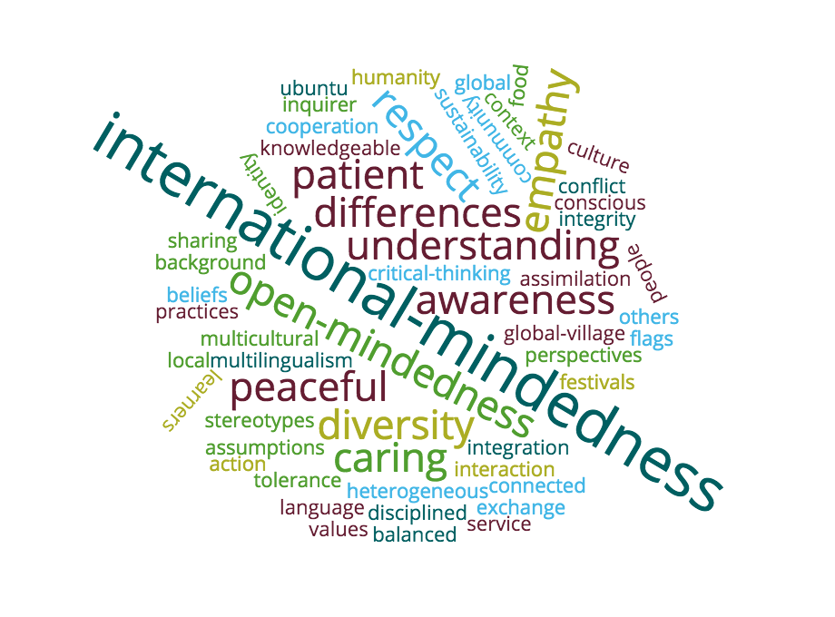
International-mindedness

Slide 11
Is the IB Program for my child?
Considerations
Student/Parent Buy-in
Time Management & Organization
Minimalism & Procrastination
Study Habits/Student Achievement
Motivation & Positivity
Response to Adversity
Self-reflection
Self-advocacy
School Involvement
Character
Tolerance

Slide 12
Satellite Busing
Parents must submit transportation application and call prior to school year to secure spot.
Once the student has been approved and assigned a bus & stop location, Denise Clark will notify the parent.
The current out of zone transportation offers for 2020-2021 are:
Colchester & Fuller (by Spring Hill Elementary)
Challenger K-8 Bus Loop
Southern Hills Blvd & Plantation Club
St. Andrews & Heather Golf Club
MLK & School St (This is the Cross Busing Stop)
Grand Entrada & Round About

Slide 13
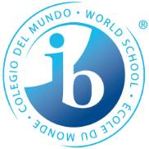
The IB Programme at SHS
SHS sees the IB Program as a skill-building program that focuses on college readiness as well as a program that forges well rounded students & lifelong learners
Bedrock of Program = combination of AP and IB classes
Students will sit for 5+ AP exams and 6+ IB exams
Florida Exam Credit Equivalency Policy: Qualifying scores on AP & IB exams translate to college credit
Yes- it is more rigorous than a “traditional” education and colleges and universities acknowledge that!
Students work towards earning the IB Diploma*- satisfies FL and HCSB graduation requirements

Slide 14
How strong is the AP program at SHS?
Year | Total # of AP exams | Exam Pass % | % of test takers passing at least 1 AP exam
2017-2018 | 620 | 73% | 77%
2018-2019 | 702 | 71% | 71%
2019-2020 | 1007 | 59% | 66%
SHS offers 19 AP classes
SHS administers 62% of district AP exams
SHS students are responsible for 69% of the qualifying AP scores

Slide 15
Students who scored a 2 or higher on an AP Exam were more likely than other students to earn a bachelor’s degree within 4 years

Slide 16
What does the IB High School experience look like?
Traditional high school experience with a rigorous academic schedule
9th and 10th grades: students labeled as “pre-IB”
Blended classes- regular, Honors and Advanced Placement
11th and 12th grades: students begin IB Diploma Program
Blended & IB: Advanced Placement & IB Classes
All 4 years- student involvement in athletics, band, clubs, theatre, etc…
All 4 years- elements of the IB Learner Profile and the concept of International-mindendess are imbedded into instruction

Slide 17
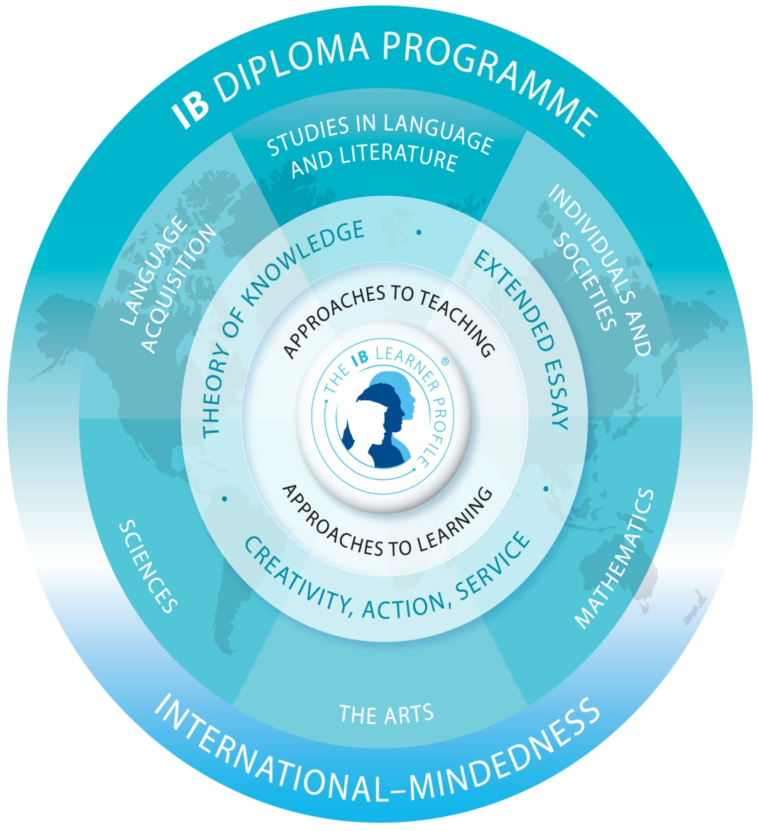

Slide 18
IB Diploma Programme Curriculum
Students work towards earning the IB Diploma in the 11th and 12th grades
Students must earn 24/45 points*
Students must take 3 HL classes over 2 years
Students must take 3 SL classes over 1 or 2 years:
Completion of the IB core (grades 11-12):
Extended Essay (EE): 4000 word research paper
Theory of Knowledge (ToK): Class- Presentation and Reflective Essay
Creativity, Action, Service (CAS): aligning 18+ months of continuous documentation to objectives

Slide 19
Springstead High School IB Programme Course Progression Schedule: 2020-2021
IB Group | 9th Grade | 10th Grade | 11th Grade | 12th Grade
1 HL | English 1 HRs (1001320H) | English 2 HRs (1001350H) | English Lang & Lit 1 IB (1005850B) | English Lang & Lit 2 IB (1005855B- IB HL Exam)
 | English 2 HRs (1001350H) | AP Engl Lang or AP Engl Lit (1001420P) (1001430P) (AP Exam) (AP Exam)
2 SL or HL | Spanish 2 (0708350Z) | DE Spanish I/II (SPN2220Z/SPN2221Z) or Spanish 3 HRs (0708360H- Non-PERT) or AP Span Lang or AP Span Lit (0708400P) (0708410P) (AP Exam) (AP Exam) | Spanish 4 IB (0708830B) | Spanish 5 IB (0708840B- IB SL Exam) or Spanish 6 IB (0708865B- IB HL Exam)
 | Latin 1 (0706300Z) | Latin 2 (0706310Z) | Latin 4 IB (0706830B) | Latin 5 IB (0706840B- IB SL Exam) or Latin 6 IB (0706845B- IB HL Exam)
3 SL or HL | AP Human Geography (2103400P- AP Exam) | AP World History (2109420P- AP Exam) | AP U.S. History (2100330P- AP Exam) --------------------------------- Soc & Cult Anthro 2 IB (2101810B- IB SL Exam) or Environmental Systems 2 IB (2001375B- IB SL Exam) or World Religions 2 IB* (2105890B- IB SL Exam) | Contemporary History 2 IB (2109805B- IB HL Exam) ----------------------------------- Soc & Cult Anthro 2 IB (2101810B- IB SL Exam) or Environmental Systems 2 IB (2001375B- IB SL Exam) or World Religions 2 IB* (2105890B- IB SL Exam)
4 SL or HL | Biology 1 Honors (2000320H) | Chemistry 1 Honors (2003350H) | AP Biology (2000340P- AP Exam) --------------------------------- Environmental Systems 2 IB (2001375B- IB SL Exam) or Sports & Ex Science 2 IB (2001830B- IB SL Exam) or Chemistry 2 IB* (2003810B- IB SL Exam) | Biology 3 IB (2000820B- IB HL Exam) ----------------------------------- Environmental Systems 2 IB (2001375B- IB SL Exam) or Sports & Ex Science 2 IB (2001830B- IB SL Exam) or Chemistry 2 IB* (2003810B- IB SL Exam)

Slide 20
Springstead High School IB Programme Course Progression Schedule: 2020-2021
IB Group | 9th Grade | 10th Grade | 11th Grade | 12th Grade
5 Math SL | Geometry HRs (1206320H) | Algebra 2 HRs (1200340H) | IB Math: Apps/Int 1 (1209300B) or IB Math: Anlys/Appr 1 (1201325B) | IB Math: Apps/Int 2 (1209305B- IB SL Exam) or IB Math: Anlys/Appr 2 (1201330B- IB SL Exam)
 | Algebra 2 HRs (1200340H) | IB Math: Anlys/Appr 1 (1201325B) | IB Math: Anlys/Appr 2 (1201330B- IB SL Exam) | AP Calculus AB (1202310P- AP Exam) or Study Hall or Elective
6 Theatre HL | Acting 1 | Acting 2 | IB Theatre 1 (0400810B) | IB Theatre 3 HL (0400830B- IB HL Exam)
6th Subject SL | Elective | AP Micro/AP Macro Econ (2102360P/2102370P- AP Exams) | Economics 2 IB (2102820B- IB SL Exam) | Study Hall or Elective
 |  | AP Environmental Science (2001380P- AP Exam) or AP Psychology (2107350P-AP Exam) or AP Comp Govt/U.S. Govt (2106430P/2106420P- AP Exams) | Chemistry 2 IB* (2003810B- IB SL Exam) Social & Cult Anthro 2 IB (210810B- IB SL Exam) Sports & Exer Science 2 IB (2001830B- IB SL Exam) Environ Systems 2 IB (2001375B- IB SL Exam) World Religions 2 IB* (2105890B- IB SL Exam)
7th Class | Study Hall | Study Hall or Elective | Study Hall or Elective | Theory of Knowledge (0900800B- Semester 1) (0900810B- Semester 2)
IB Electives (6th subjects or extra class) | N/A | N/A | Chemistry 2 IB (Group 4 or 6th Subject) (2003810B- IB SL Exam) Social & Cult Anthropology 2 IB (Group 3 or 6th Subject) (210810B- IB SL Exam) Sports & Exercise Science 2 IB (Group 4 or 6th Subject) (2001830B- IB SL Exam) Environmental Systems 2 IB (Group, 3, 4 ,or 6th Subject) (2001375B- IB SL Exam) World Religions 2 IB (Group 3 or 6th subject) (2105890B- IB SL Exam)

Slide 21
The IB Diploma
IB Diploma Points Calculation
Group 1- English Lang & Lit HL x/7 points
Group 2- Foreign Lang SL/HL x/7 points
Group 3: Ind & Societies SL/HL x/7 points
Group 4: Science SL/HL x/7 points
Group 5: Mathematics SL x/7 points
6th subject SL x/7 points
CAS Satisfied
Extended Essay D or Higher
Theory of Knowledge D or Higher
EE/ToK Bonus Points x/3 points
IB Diploma awarded with minimum of 24/45 points & conditions met*
IB Diploma = 100% Bright Futures Academic Scholarship

Slide 22
IB Performance Data (2012-2020)

Slide 23
IB Facts
“Facts are stubborn things; and whatever may be our wishes, our inclinations, or the dictates of our passion, they cannot alter the state of facts and evidence.” – John Adams
IB DP Students are more likely to:
Enroll in college
Attend a more selective college
Stay enrolled in college
To attend college full-time, with nearly 70% attending selective or more selected colleges.
Graduate from college at higher rates, with 81% of IB students graduating within 6 years of enrolling full-time at a 4-year institution, compared to the national average of 57%.
The average acceptance rate of IB students into university/college is 22% higher than the average acceptance rate of the total population.

Slide 24
IB students more prepared for college
2012 study of Chicago public schools interviewed Diploma Programme alumni and found that:
Students reported they felt prepared by the Diploma Programme to succeed in college.
Students reported that they:
felt prepared to succeed and excel in their coursework
had strong academic skills, especially related to analytical writing
learned academic behaviours like work ethic, motivation, time management, and help-seeking that were sources of strength in the transition to college-level work
identified preparation in the IB programme as the source of their success as college students.
Notes:
Key messages about college readiness and success
IB students report feeling more able to tackle the challenges of college
IB students do better in college, with IB participation predicting college GPA and better performance on IB exams predicting better performance in college courses
IB students have higher persistence and graduation rates in college
As part of the study of IB students in Chicago public schools cited in the previous slide, researchers conducted qualitative analysis of interviews with 25 primarily low-income and minority Chicago public schools Diploma Programme alumni. Researchers found students felt very well prepared for college in terms of academic skills and behaviours. As cited in the previous slide, the quantitative analysis in this study demonstrated that students were more likely to attend, and persist in, college.
A summary of the Chicago Public Schools study can be found here: http://www.ibo.org/research/policy/programmevalidation/diploma/documents/CPSResearchsummaryFinal3-3-12.pdf

Slide 25
University or college | IB students acceptance rate | Total population acceptance rate | IB students vs total population
University of Florida | 82% | 42% | +40%
Florida State University | 92% | 60% | +32%
Brown University | 18% | 9% | +9%
Stanford University | 15% | 7% | +8%
Columbia University | 13% | 9% | +4%
University of California - Berkeley | 58% | 26% | +32%
Harvard University | 10% | 7% | +3%
New York University | 57% | 30% | +27%
University of Michigan - Ann Arbor | 71% | 51% | +20%
University of Miami | 72% | 30% | +42%
Source: IBDP Graduate Destinations Survey 2011/12 conducted by i-graduate International Insight
Strictly copyright © IGI Services 2011
Notes:
The IB surveyed all IB world schools in the United States registering students for Diploma exams in May 2011 and all US 12th graders registered for exams about their college application process. According to student self-reports, IB students are admitted to college and universities at higher rates than the general population.
This slide shows the Universities most commonly applied to by US Diploma candidates, and demonstrates that IB students have higher acceptance rates than the average acceptance rates for the university.

Slide 26
University or College | IB students acceptance rate | Total population acceptance rate | IB students vs total population
Cornell University | 31% | 18% | +13%
Duke University | 28% | 16% | +12%
University of Pennsylvania | 24% | 14% | +10%
Yale University | 18% | 7% | +11%
University of Central Florida | 90% | 47% | +43%
Boston University | 70% | 58% | +12%
University of California - Los Angeles | 48% | 23% | +25%
University of Virginia | 64% | 32% | +32%
UNC Chapel Hill | 63% | 32% | +31%
Princeton University | 16% | 8% | +8%
Source: IBDP Graduate Destinations Survey 2011/12 conducted by i-graduate International Insight
Strictly copyright © IGI Services 2011
Notes:
The IB surveyed all IB world schools in the United States registering students for Diploma exams in May 2011 and all US 12th graders registered for exams about their college application process. According to student self-reports, IB students are admitted to college and universities at higher rates than the general population.
This slide shows the Universities most commonly applied to by US Diploma Candidates, and demonstrates that IB students have higher acceptance rates than the average acceptance rates for the university.

Slide 27
What’s the next step?
Review ALL options with your child
If you interested in applying for the IB Programme at SHS:
Signup for interview (parent and student)- held at SHS or through Zoom, 7:30am to 11:00am
Bring completed IB Packet to interview: SHS Pre-IB Application, SHS IB Mature Contents Form, and SHS IB Student Honor Code
ALL applicants will be notified by mail in February 2021- accepted vs. wait listed
If accepted to the IB Programme:
Ensure that student has completed Algebra I And/or Spanish I (if taking Spanish track) PRIOR to entry into the 9th grade
Out of zone students:
Apply for special attendance/school choice on HCSB website (Opens 1/4/2021)
Apply for transportation (June)
Non- HCSB students will need to register at SHS in June after 8th grade promotion
Attend 8th grade IB orientation in August of 2021

Slide 28
General Q & A

