Slide 1
Mr. John Imhof- IB Coordinator 797-7010 ext.239 imhof_ j@hcsb.k12.fl.us
F.W. Springstead High School

Slide 2
Student Learning Opportunities in Hernando County
Attend zoned high school- take variety of Honors and Advanced Placement Courses; traditional Bright Futures
NCTHS- Vocational Programs; DE & AP Classes; traditional Bright Futures (Zone and Magnet)
CHS- AICE Program; AP & AICE Classes; AICE Diploma = 100% Bright Futures (Magnet)
Dual Enrollment- pass PERT test; take DE on school or PHSC Campus, earn college credit (Zone Only- classes vary by site)
SHS- International Baccalaureate- IB Diploma Programme; AP Capstone Program; AP and IB Classes; IB Diploma = 100% Bright Futures (Magnet)

Slide 3
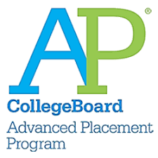
High School Paths

Slide 4
College Admissions Factors
Weighted GPA/Class Rank
SAT/ACT Scores
Strength of Schedule (Rigor)
School Profile- class size, subjects offered, etc…
Letter of Recommendation*
AP Classes (20):
Biology
Calculus AB
Capstone: Seminar
Capstone: Research
Comparative/U.S. Govt & Pol
English Language
English Literature
Environmental Science
Human Geography
Macroeconomics/ Microeconomics
Music Theory*
Psychology
Spanish Language
Spanish Literature
Statistics
Studio Art
U.S. History
World History
IB Classes (13):
Biology HL
Chemistry SL*
English Language & Literature HL
Environmental Systems SL
History of the Americas HL
Latin SL/HL
Math Applications & Interpretations SL
Math Analysis & Approaches SL
Physics SL*
Spanish B SL/HL
Sports & Exercise Science SL
Social/Cultural Anthropology SL
World Religions SL*

Slide 5
University Admissions- You be the Judge?
Student A: 4.0 Weighted GPA, 85/400
Student B: 4.4 Weighted GPA, 20/400
Grade 9:
English 1 Honors
Algebra 1 Honors
Spanish 1
Biology 1 Honors
Team Sports
Hope
Grade 10:
English 2 Honors
Geometry Honors
Spanish 2
Marine Science Honors
World History Honors
Weightlifting
Music Appreciation
Grade 11:
English 3 Honors
Algebra 2 Honors
Phys Sci Honors
AP U.S. History
Online Class
Basketball
Grade 12:
English 4 Honors
Pre- Calculus
AP U.S./Comp Govt
AP Macro/Micro
Elective
Elective
Grade 9:
English 1 Honors
Geometry 2 Honors
Spanish 2 Honors
Biology 1 Honors
AP Human Geo
Band
Grade 10:
Pre-IB English 2 Honors
Algebra 2 Honors
Spanish 3 Honors
AP World History
Chemistry 1 Honors
AP Macro/Micro
AP Comp/U.S. Govt
Grade 11:
IB English Lang 1
IB Math 1*
IB Spanish 4
AP Bio
AP U.S. History
IB Econ 2
IB Sports Science
Grade 12:
IB English Lang 3
IB Math 2*
IB Spanish 5
IB Bio 3
IB History 3
IB World Religions

Slide 6
University Admissions Standards
School | HS Weighted GPA | SAT | ACT
 | 4.3+ | 1330+ | 29+
 | 4.1+ | 1270+ | 28+
 | 3.8+ | 1300+ | 29+
 | 4.1+* | 1330+* | 29+*

Slide 7
Understanding Bright Futures
Florida Bright Futures- State Tuition Scholarship program for FL state colleges/universities
Academic Scholarship- 100% tuition up to 4 years* + $300 semester expenditure stipend
Medallion Scholarship- 75% tuition up to 4 years*
Type | HS Weighted GPA | ACT/SAT Requirements | Service Hours | College GPA for Renewal
Florida Academic Scholarship | 3.50 | 29/1330 [90th Percentile] or IB or AICE Diploma | 100 | 3.0 + maintain credit hours
Florida Medallion Scholarship | 3.00 | 25/1210 | 75 | 2.75 + maintain credit hours

Slide 8
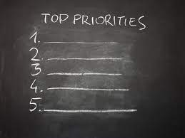
Skill based college preparation
College Credit
Grades
Rigorous curriculum
Development of well rounded, internationally minded students

Slide 9
Is the IB Program for my child?
Considerations
Student/Parent Buy-in
Time Management & Organization
Minimalism & Procrastination
Study Habits/Student Achievement
Motivation & Positivity
Response to Adversity- aka “Stress”
Self-reflection
Self-advocacy
School Involvement
Character

Slide 10
Satellite Busing
Parents must submit transportation application and call prior to school year to secure spot.
Once the student has been approved and assigned a bus & stop location, Denise Clark will notify the parent.
The current out of zone transportation offers for 2021-2022 are:
St. Andrews & Heather Golf Club
MLK & School St (This is the Cross Busing Stop)
Hernando Oaks (Grand Entrada & Round About)
Century Dr & Keyes Ave
Coronado Dr & Dumont Ave
Chippendale St & Ring Rd
Trillium Blvd & Pool Entrance

Slide 11
Who and what is the IB?
The IB is…
A 2 year academic program
An educational philosophy
A way of thinking/acting
A greater sense of community
Who is the IB?
The IB, or the International Baccalaureate Organization, aims to develop inquiring, knowledgeable and caring young people who help to create a better and more peaceful world through intercultural understanding and respect.
What does the IB do?
The IB develops a challenging secondary programme/course of study of international education and rigorous assessment.
What is the goal of the IB?
To encourage students across the world to become active, compassionate and lifelong learners who understand that other people, with their differences, can also be right- “International Mindedness”

Slide 12
The IB Student “Profile” (Student Attributes and development of Lifelong Learners) “Developing the student learner profile is the goal, not the standard”

Slide 13
What does the IB High School experience look like?
Pre-IB Years
Grades 9 & 10
Students labeled as “pre-IB”
Blended classes- regular, Honors and Advanced Placement
IB Diploma Years
Grades 11 & 12
Students begin IB Diploma Program
Advanced Placement & IB Classes
ALL 4 Years
Traditional high school experience with a rigorous academic schedule
All 4 years- student involvement in athletics, band, clubs, theatre, etc…
All 4 years- elements of the IB Learner Profile and the concept of International-mindendess are imbedded into instruction

Slide 14
The IB Programme at SHS
SHS sees the IB Program as a skill-building program that focuses on college readiness as well as a program that forges well rounded students & lifelong learners
Bedrock of Program = combination of AP and IB classes
Students will sit for 5+ AP exams and 6+ IB exams
Florida Exam Credit Equivalency Policy: Qualifying scores on AP & IB exams translate to college credit
Yes- it is more rigorous than a “traditional” education and colleges and universities acknowledge that!
Students work towards earning the IB Diploma*- satisfies FL and HCSB graduation requirements

Slide 15
The AP program at SHS?
Year | Total # of AP exams | Exam Pass % | % of test takers passing at least 1 AP exam
2017-2018 | 620 | 73% | 77%
2018-2019 | 702 | 71% | 71%
2019-2020 | 1007 | 59% | 66%
2020-2021 | 963 | 51% | 59%
2021-2022 | 895 | 55% | 60%
SHS offers 20 AP classes
SHS administers 40+% of district AP exams
SHS students are responsible for 50+% of the qualifying AP scores

Slide 16
Students who scored a 2 or higher on an AP Exam were more likely than other students to earn a bachelor’s degree within 4 years

Slide 17
IB Performance Data (2015-2022)

Slide 18
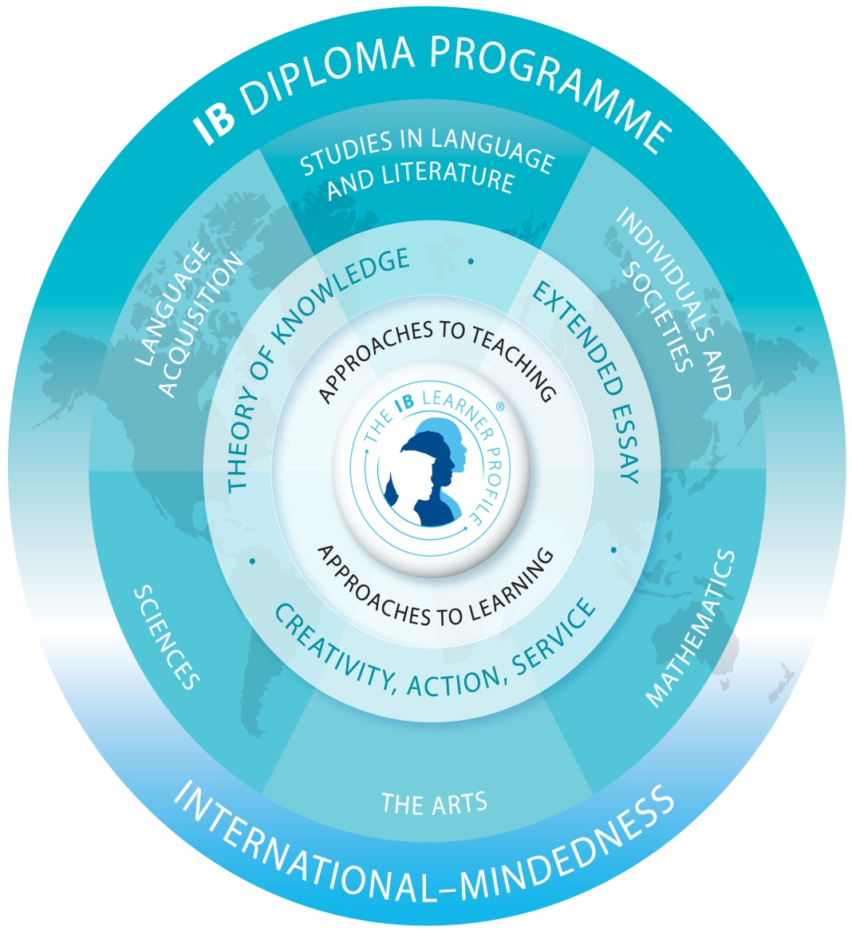

Slide 19
IB Diploma Programme Curriculum
Students work towards earning the IB Diploma in the 11th and 12th grades
Students must earn 24/45 points*
Students must take 3 HL classes over 2 years
Students must take 3 SL classes over 1 or 2 years:
Completion of the IB core (grades 11-12):
Extended Essay (EE): 4000 word research paper
Theory of Knowledge (ToK): Class Presentation and Reflective Essay
Creativity, Action, Service (CAS): aligning 18+ months of continuous documentation to objectives

Slide 20
Springstead High School IB Programme Course Progression Schedule
IB Group | 9th Grade | 10th Grade | 11th Grade | 12th Grade
1 HL | Pre-AP Eng 1 (1001415) | Pre-AP Eng 2 (1001416) | English Lang & Lit 1 IB (1005850) | English Lang & Lit 3 IB (1005856- IB HL Exam)
 | Pre-AP Eng 2 (1001416) | AP Eng Lang & Comp (1001420) (AP Exam)
2 SL or HL | Spanish 2 (0708350) | Spanish 3 HRs (0708360) or AP Span Lang or AP Span Lit (0708400) (0708410) (AP Exam) (AP Exam) | Spanish 4 IB (0708830) | Spanish 5 IB (0708840- IB SL Exam) or Spanish 6 IB (0708865- IB HL Exam)
 | Latin 1 (0706300) | Latin 2 (0706310) | Latin 4 IB (0706830) | Latin 5 IB (0706840- IB SL Exam) or Latin 6 IB (0706845- IB HL Exam)
3 SL or HL | AP Human Geography (2103400- AP Exam) | AP World History (2109420- AP Exam) | AP U.S. History (2100330- AP Exam) --------------------------------- Soc & Cult Anthro 2 IB* (2101810- IB SL Exam) or Environmental Systems 2 IB (2001375- IB SL Exam) or World Religions 2 IB* (2105890- IB SL Exam) | Contemporary History 2 IB (2109805- IB HL Exam) ----------------------------------- Soc & Cult Anthro 2 IB* (2101810- IB SL Exam) or Environmental Systems 2 IB (2001375- IB SL Exam) or World Religions 2 IB* (2105890- IB SL Exam)
4 SL or HL | Biology 1 Honors (2000320) | Chemistry 1 Honors (2003350) Or Physics 1 Honors (2003390) | AP Biology (2000340- AP Exam) --------------------------------- Environmental Systems 2 IB (2001375- IB SL Exam) or Sports & Ex Science 2 IB (2001830- IB SL Exam) or Chemistry 2 IB* (2003810- IB SL Exam) or Physics 2 IB* (2003845- IB SL Exam) | Biology 3 IB (2000820- IB HL Exam) ----------------------------------- Environmental Systems 2 IB (2001375- IB SL Exam) or Sports & Ex Science 2 IB (2001830- IB SL Exam) or Chemistry 2 IB* (2003810- IB SL Exam) or Physics 2 IB* (2003845- IB SL Exam)

Slide 21
Springstead High School IB Programme Course Progression Schedule
IB Group | 9th Grade | 10th Grade | 11th Grade |  | 12th Grade
5 Math SL | Geometry HRs (1206320) | Algebra 2 HRs (1200340) | IB Math: Apps/Int 1 (1209300) or IB Math: Anlys/Appr 1 (1201325) |  | IB Math: Apps/Int 2 (1209305- IB SL Exam) or IB Math: Anlys/Appr 2 (1201330- IB SL Exam)
 | Algebra 2 HRs (1200340) | IB Math: Apps/Int 1 (1209300) or IB Math: Anlys/Appr 1 (1201325) | IB Math: Apps/Int 2 (1209305- IB SL Exam) or IB Math: Anlys/Appr 2 (1201330- IB SL Exam) |  | AP Calculus AB* (1202310- AP Exam) Or AP Statistics* (1210320- AP Exam) or Study Hall or Elective
6th Subject SL | Elective | AP Micro/AP Macro Econ* (2102360/2102370- AP Exams) | Economics 2 IB* (2102820- IB SL Exam) |  | Elective or ATL 2 (1700810)
 |  | AP Environmental Science (2001380- AP Exam) or AP Psychology (2107350-AP Exam) or AP Comp Govt/U.S. Govt (2106430/2106420- AP Exams) | Chemistry 2 IB* (2003810- IB SL Exam) Social & Cult Anthro 2 IB* (210810- IB SL Exam) Sports & Exer Science 2 IB (2001830- IB SL Exam) Environ Systems 2 IB (2001375- IB SL Exam) World Religions 2 IB* (2105890- IB SL Exam) Physics 2 IB* (2003845- IB SL Exam)
7th Class | Pre-IB Inquiry Skills 1 (1700360) | Elective or Capstone- Seminar (1700500- AP Exam) | Elective |  | Theory of Knowledge (0900810)
 |  |  | ATL 1 (1700800) | Capstone- Research (1700510- AP Exam)
IB Electives (6th subjects or extra class) | N/A | N/A | Chemistry 2 IB* (Group 4 or 6th Subject) (2003810- IB SL Exam) Social & Cult Anthropology 2 IB* (Group 3 or 6th Subject) (210810- IB SL Exam) Sports & Exercise Science 2 IB (Group 4 or 6th Subject) (2001830- IB SL Exam) Environmental Systems 2 IB (Group, 3, 4 ,or 6th Subject) (2001375- IB SL Exam) World Religions 2 IB* (Group 3 or 6th subject) (2105890- IB SL Exam) Physics 2 IB* (Group 4 or 6th Subject) (2003845- IB SL Exam)

Slide 22
The IB Diploma
IB Diploma Points Calculation
Group 1- English Lang & Lit HL x/7 points
Group 2- Foreign Lang SL/HL x/7 points
Group 3: Ind & Societies SL/HL x/7 points
Group 4: Science SL/HL x/7 points
Group 5: Mathematics SL x/7 points
6th subject SL x/7 points
CAS Satisfied
Extended Essay D or Higher
Theory of Knowledge D or Higher
EE/ToK Bonus Points x/3 points
IB Diploma awarded with minimum of 24/45 points & conditions met*
IB Diploma = 100% Bright Futures Academic Scholarship

Slide 23
What’s the next step?
Review ALL high school options with your child
Review IB materials/information online
If you interested in applying for the IB Programme at SHS:
Signup for interview with IB Coordinator (parent and student)- held at SHS, 9:30am to 1:30pm (10/24-12/1)- Google Calendar link on IB website
Bring completed IB Packet to interview: SHS Pre-IB Application, SHS IB Mature Contents Form, and SHS IB Student Honor Code
ALL applicants will be notified by mail in January 2023- accepted vs. wait listed
If accepted to the IB Programme:
Ensure that student has completed Algebra I And/or Spanish I (if taking Spanish track) PRIOR to entry into the 9th grade
Out of zone students:
Apply for special attendance/school choice on HCSB website (Opens 1/14/2022)
Apply for transportation (June)
Non- HCSB students will need to register at SHS in June after 8th grade promotion
Attend 8th grade IB orientation in August of 2023

Slide 24
General Q & A

